Slide 1
Differential Drive (DD)
Project by Stépane BINON
16/08/2025

Slide 2
NEXT TASKS
Command encoders and nucleo boards, desing for test bench, start learning about FOC
Videos.
https://www.youtube.com/watch?v=RNRjC5iBhJE
https://www.youtube.com/watch?v=hxK5hNAsVH0&list=PLbGlpmZLQWJceSkQv96j-L4YyuxS-E0Wm&index=4
https://chatgpt.com/g/g-p-68a0ae6b37d08191956af3703a806f26/c/68a88881-2538-8321-a30d-66c523741801

Slide 3
Specifications
Environment:
Tiled flor/flat surface, must be able to climb 20° slope, must be able to cross a 1cm gap without issues
Capacities:
With 2 wheels, 5kg of charge
Full speed at 1.1m/s (10% marge)
Acceleration => 1m/s in 0.5m at full acceleration => 2m/s² of minimal acceleration
Control:
Using position, speed or torque for each wheel

Slide 4
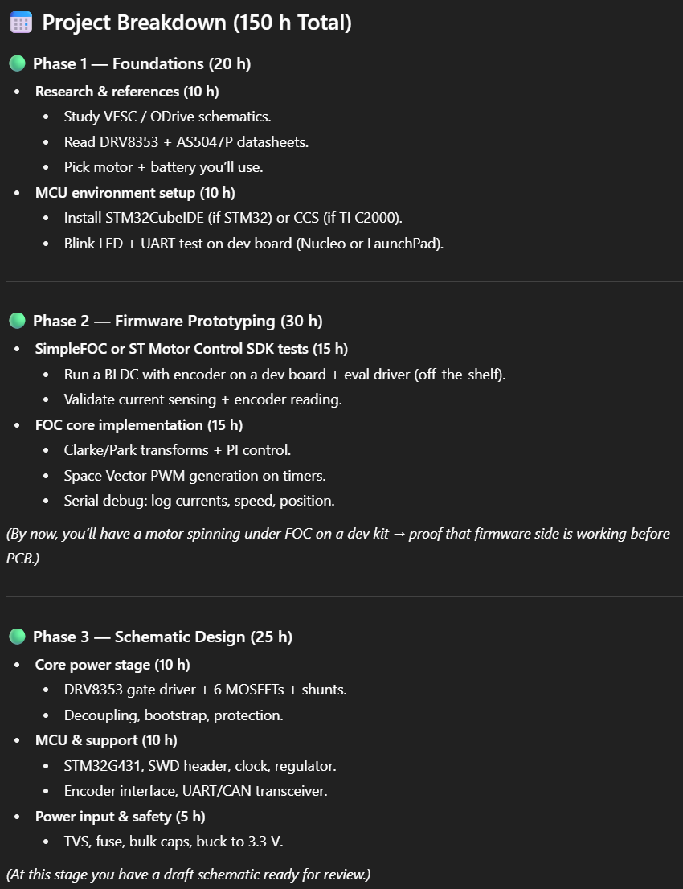
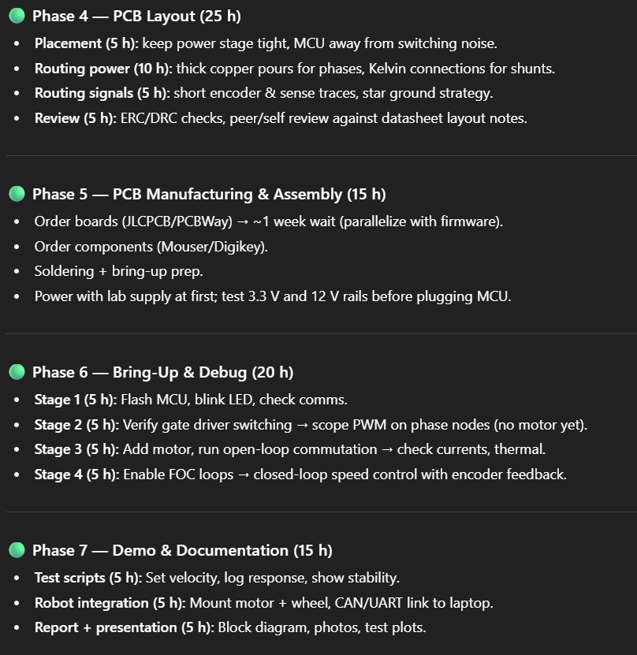

Slide 5
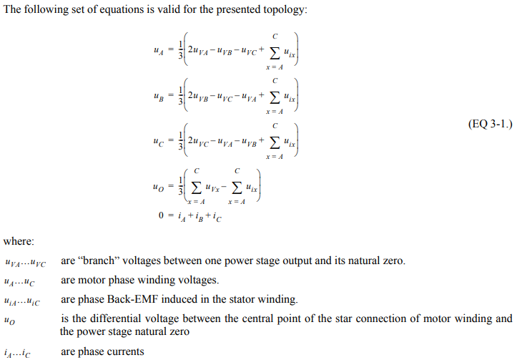
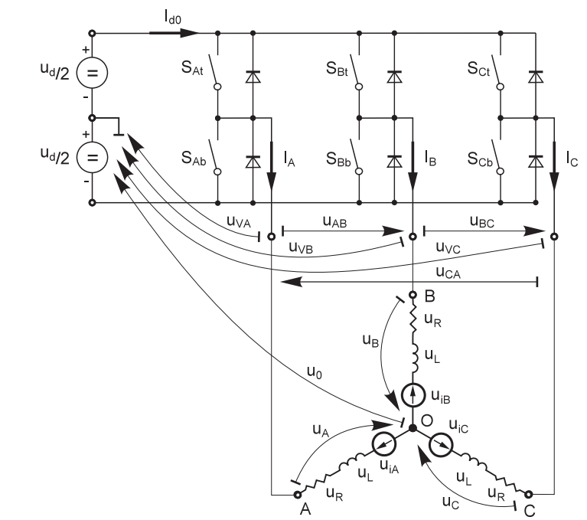
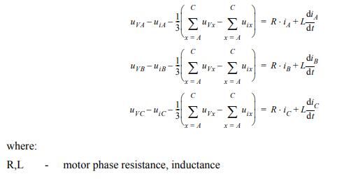
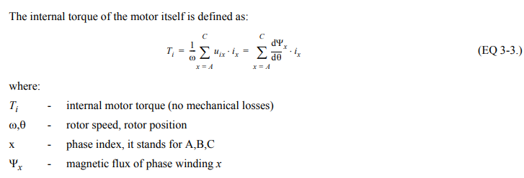
Schema of hardware

Slide 6
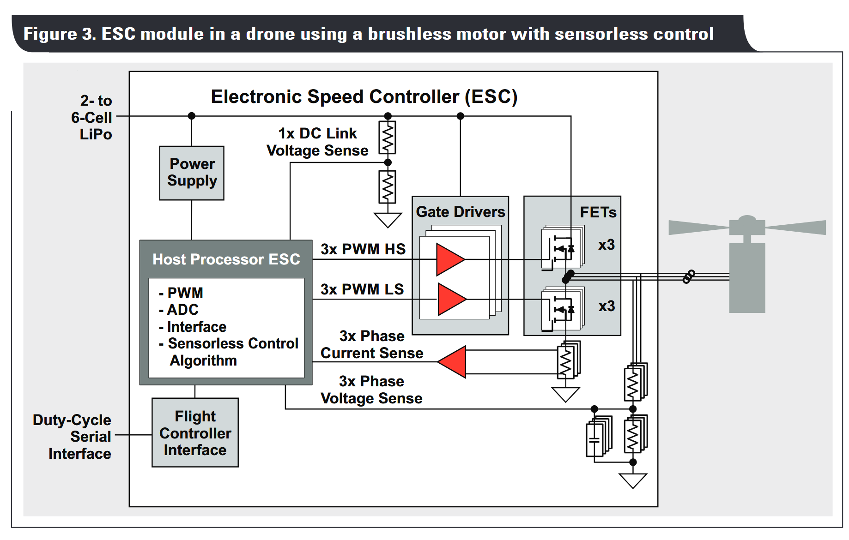

Slide 7
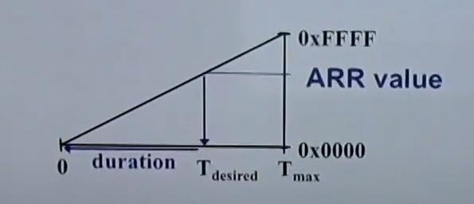
TIMERS
ARR: Auto-Reload Value

Slide 8
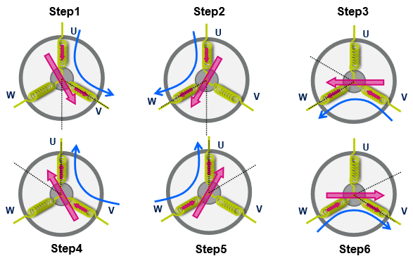
6 steps

Slide 9
Step 1: Field-Oriented Control
In a std ESC, the torque is not constant => FOC solves that => Can be seen using a slow rotating motor
Std EXC causes noise due to spike in the current shape (use an oscillosope to see it)
Std ESC is less efficient. FOC « pull » the magneet at the right time (ie torque is maximal) which ensure max efficiency => NEED POSITION.
Standard ESC: only 6 space vectors
FOC ESC: much more space vectors => almost continous

Slide 10
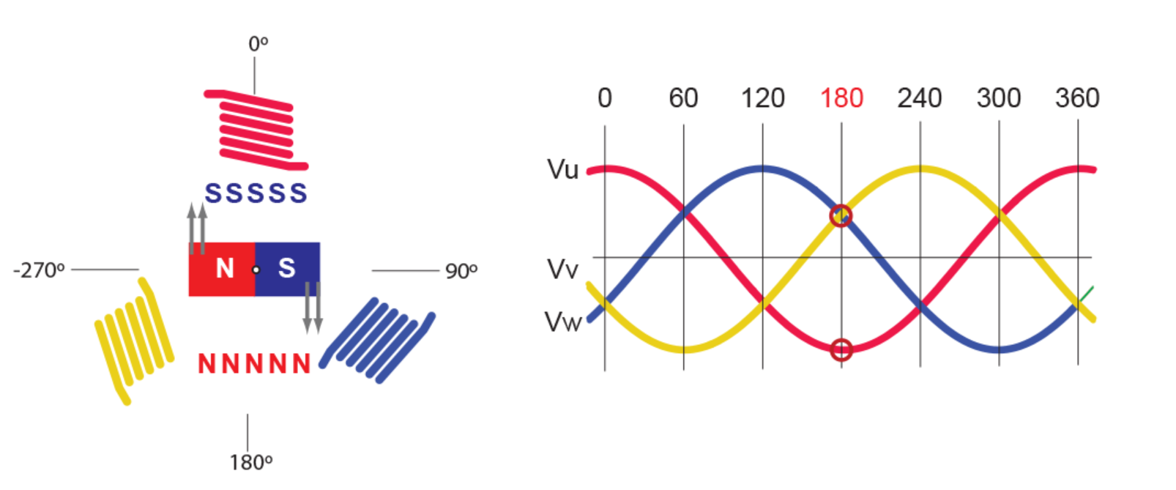
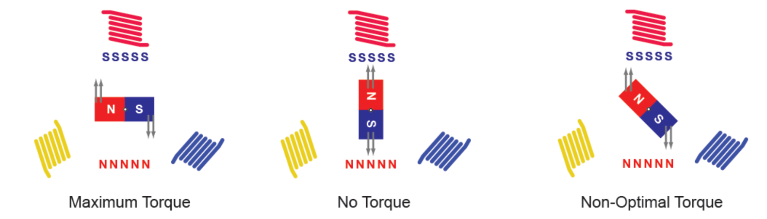
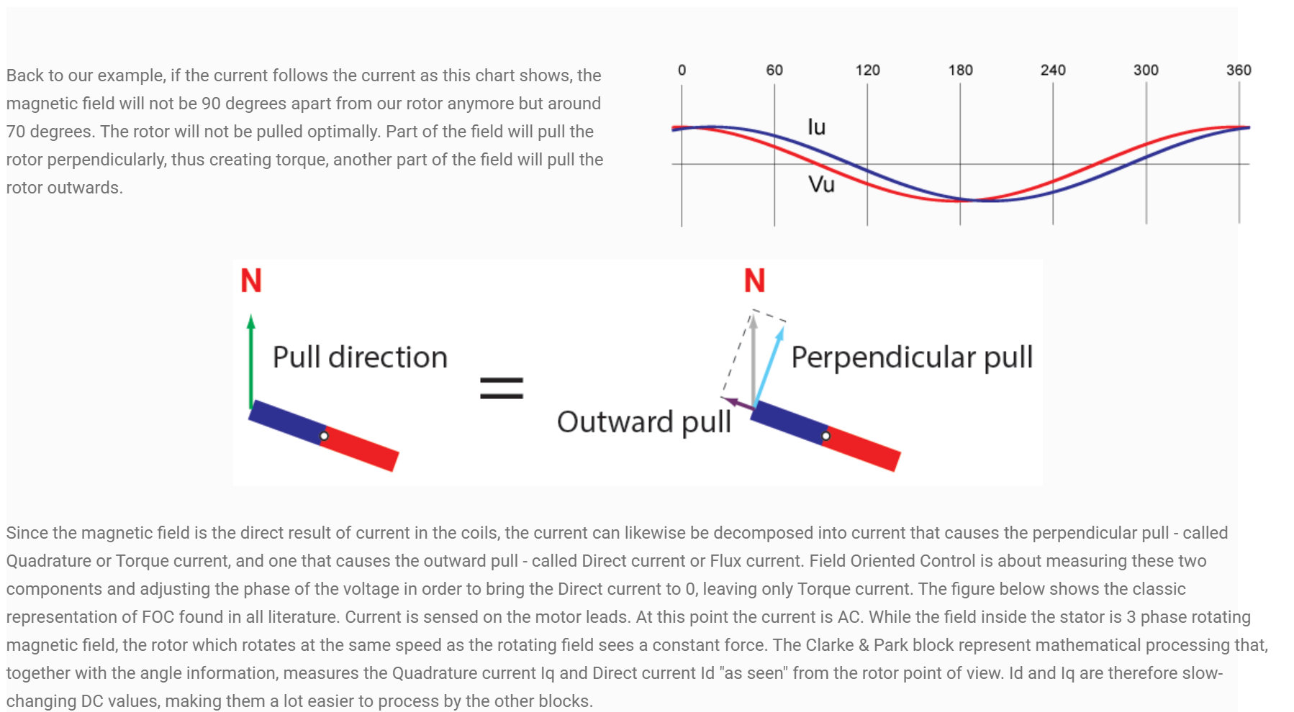
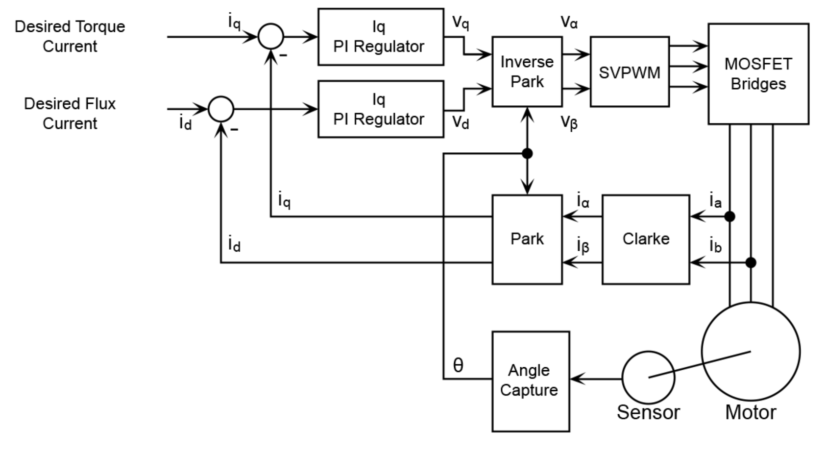

Slide 11
Motor alignement
Rampe en BO pour mise a 500RPM
Lecture des capteurs (64kHz) avec HRTIM
Securité en function du courant et de la tension
Lecture de la BEMF pour determiner la position du rotor

Slide 12



















































Slide 13
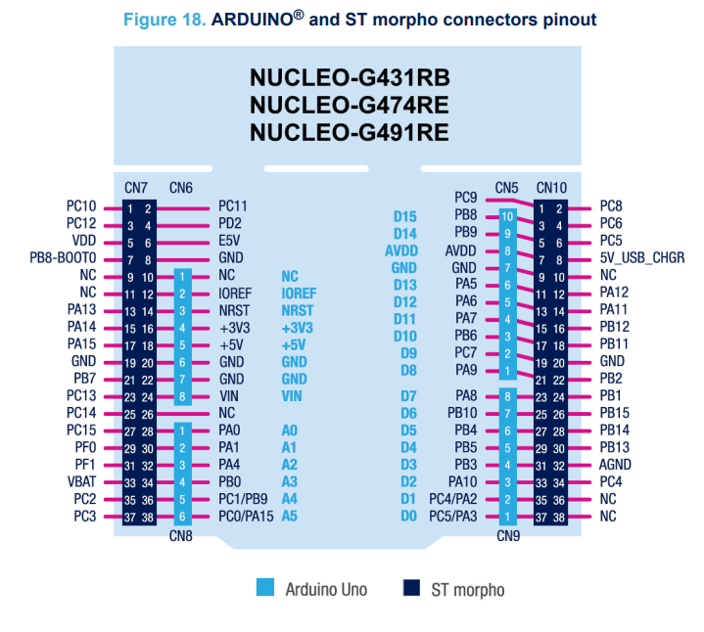
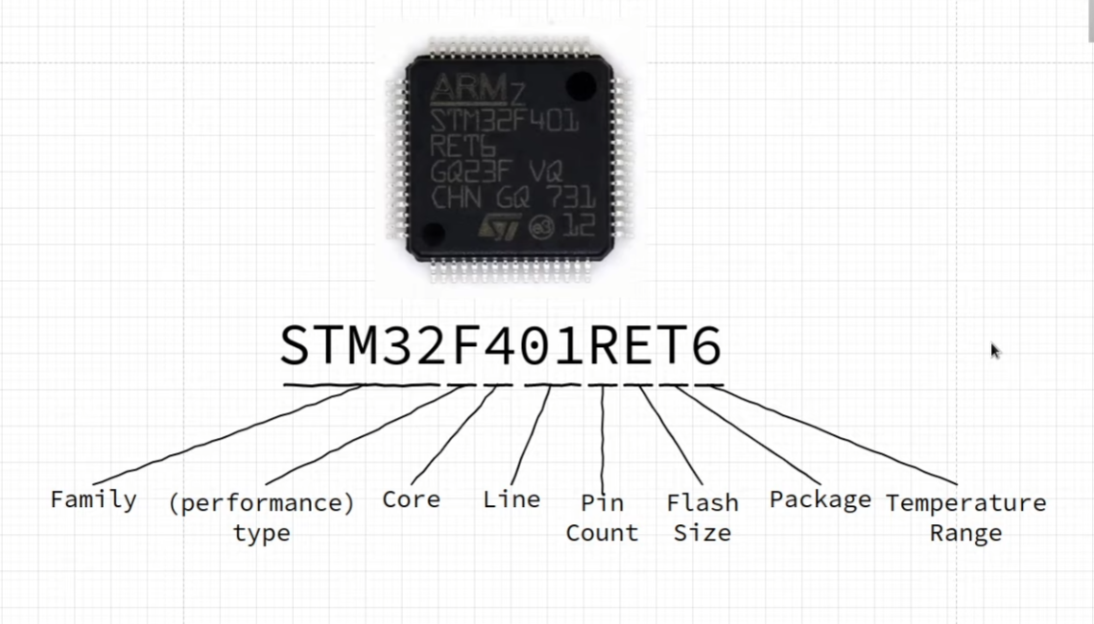
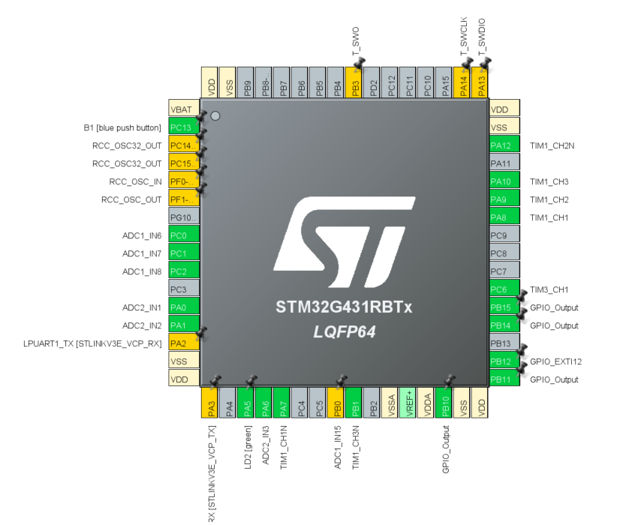









STM32

Slide 14
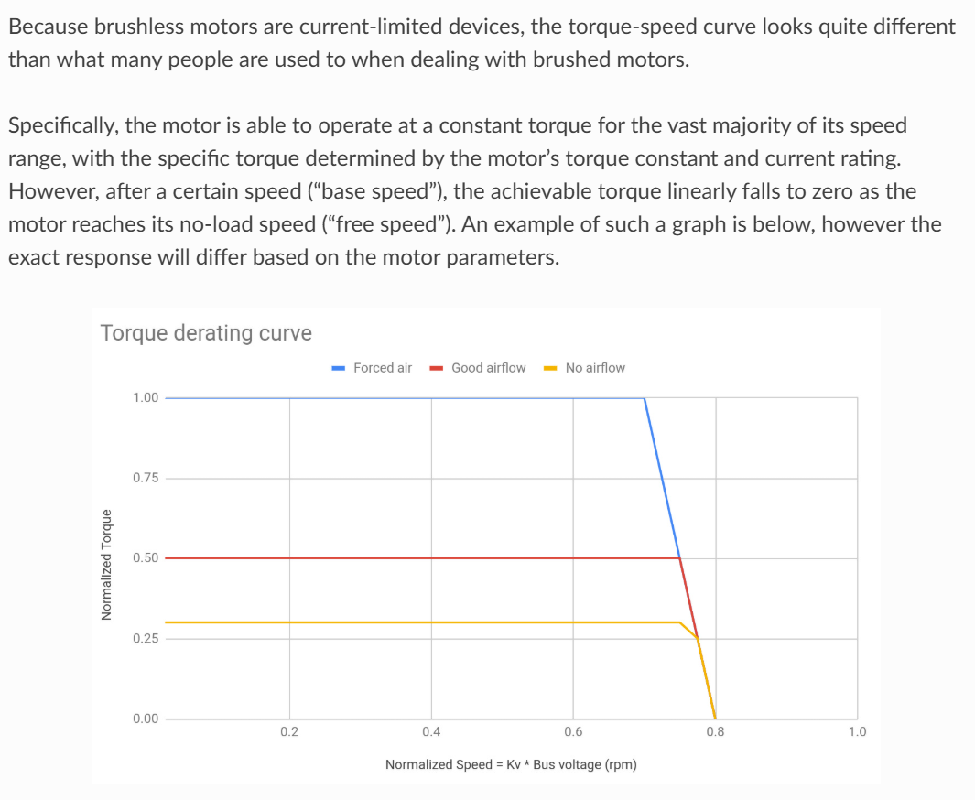
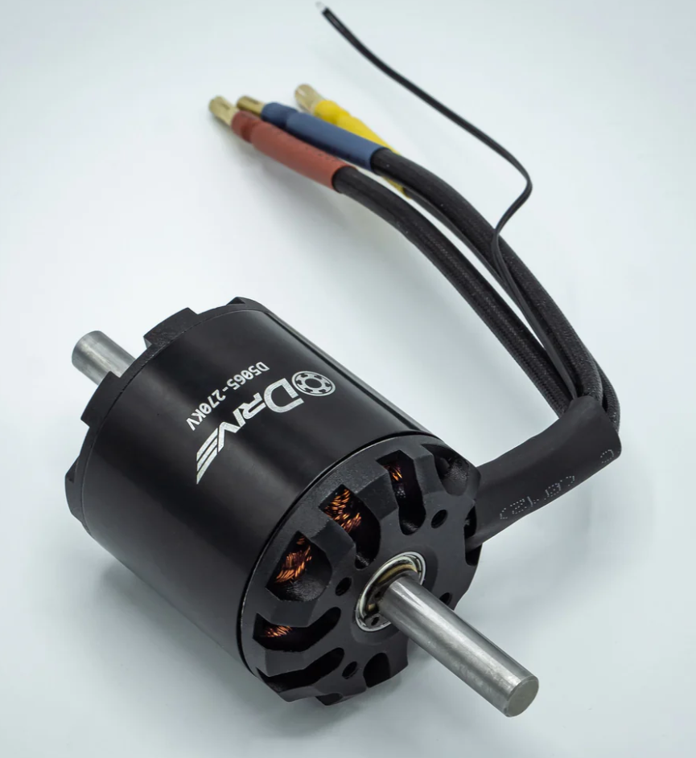
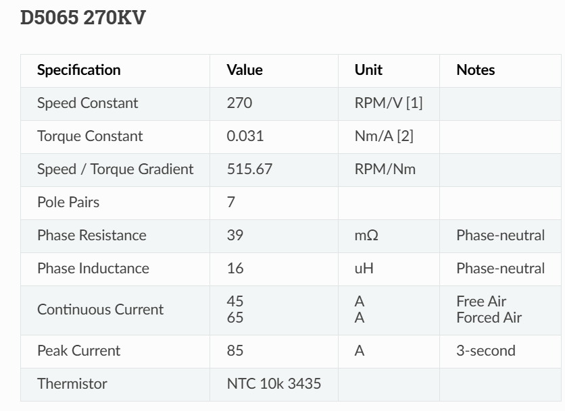
Motors: KAVAN Brushless motor C3542-1250 and ODRIVE
Dual Shaft Motor - D5065 270kv – ODrive Robotics US
Dimensions will be based on this motor to ensure performances during the French Robotic Cup.
ODrive Motors — ODrive Documentation 0.6.11 documentation

Slide 15
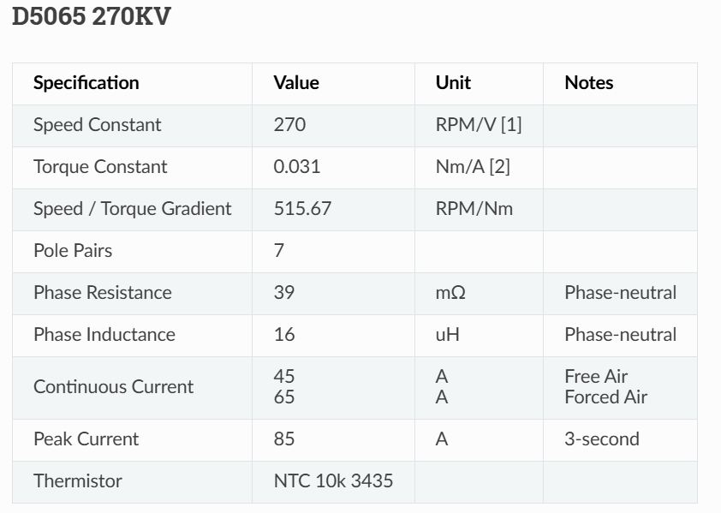
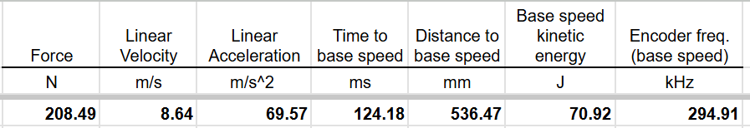
Our driver must be able to take:
85A during 3s
65A continously => seems to be way to much, thus, we will limit ourselves to (45+65)/2=55A => We will need to control power consumption
32V
Electrical frequency

Slide 16
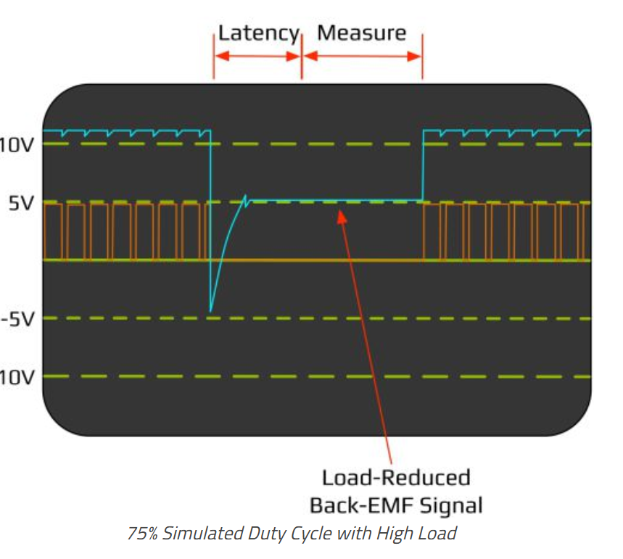
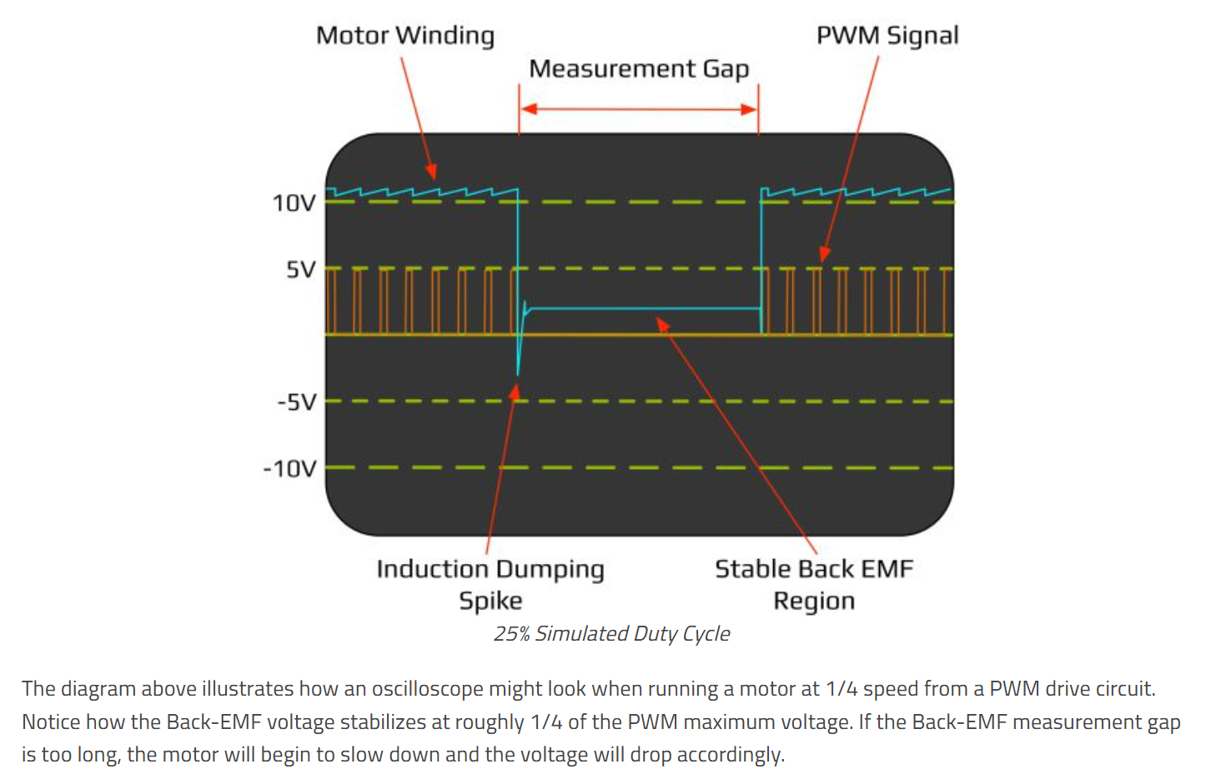


MOTOR NOISE
Must be absorbed

Slide 17
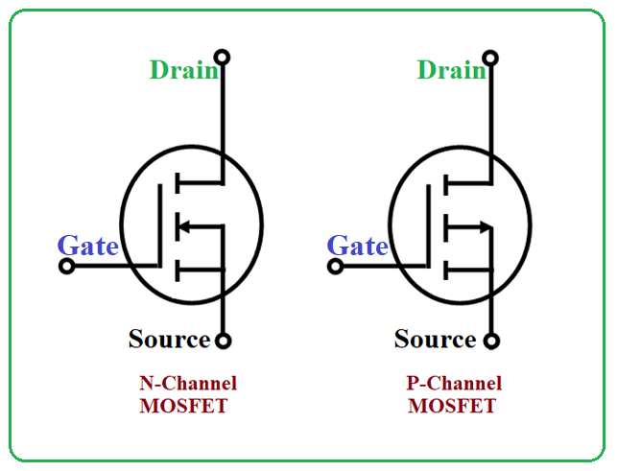
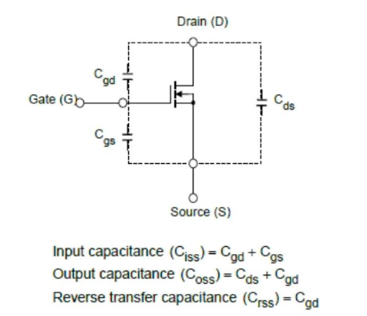
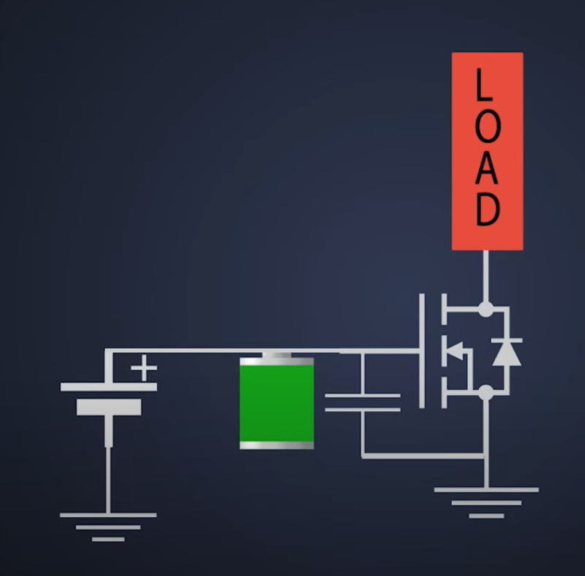
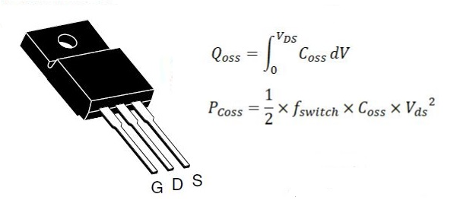
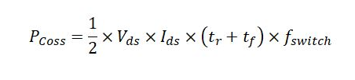






Mosfet: NVMFS5C604NLAFT1G
I_d = Drained Current (depend of cooling)
R_ds = Drain to Source Resistance
V_ds = Dran to Source Tension
Q_g: charge for on/off => affect speed
Rise/fall time and delays
Q_oss: charge for Output Capacitance Coss
Qg charge for the gate

Slide 18
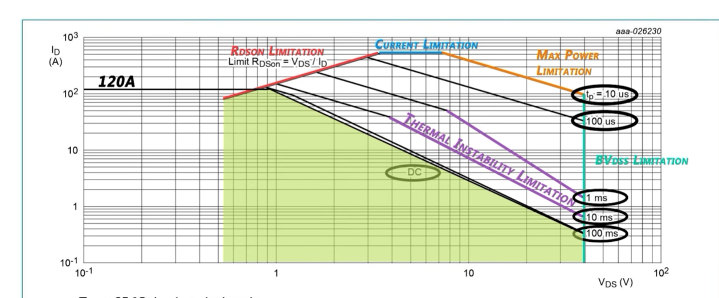
https://www.youtube.com/watch?v=86S-CEXImzU&pp=0gcJCR0AztywvtLA

Slide 19
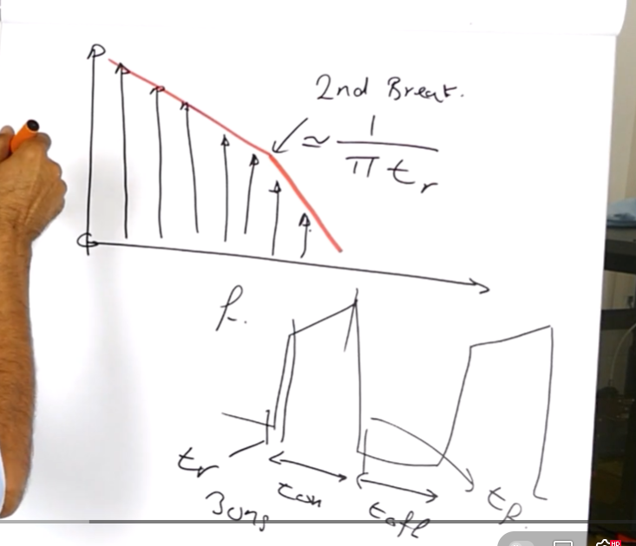
https://www.youtube.com/watch?v=_r0xtaYMjYQ

Slide 20
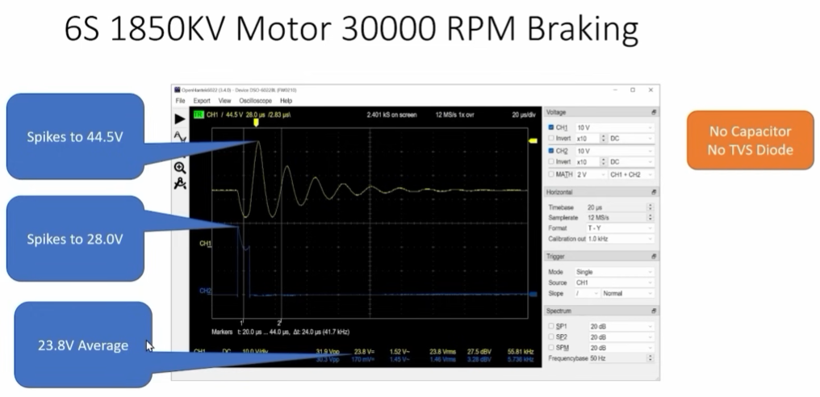
https://www.youtube.com/watch?v=VgHOHcWu7-U

Slide 21
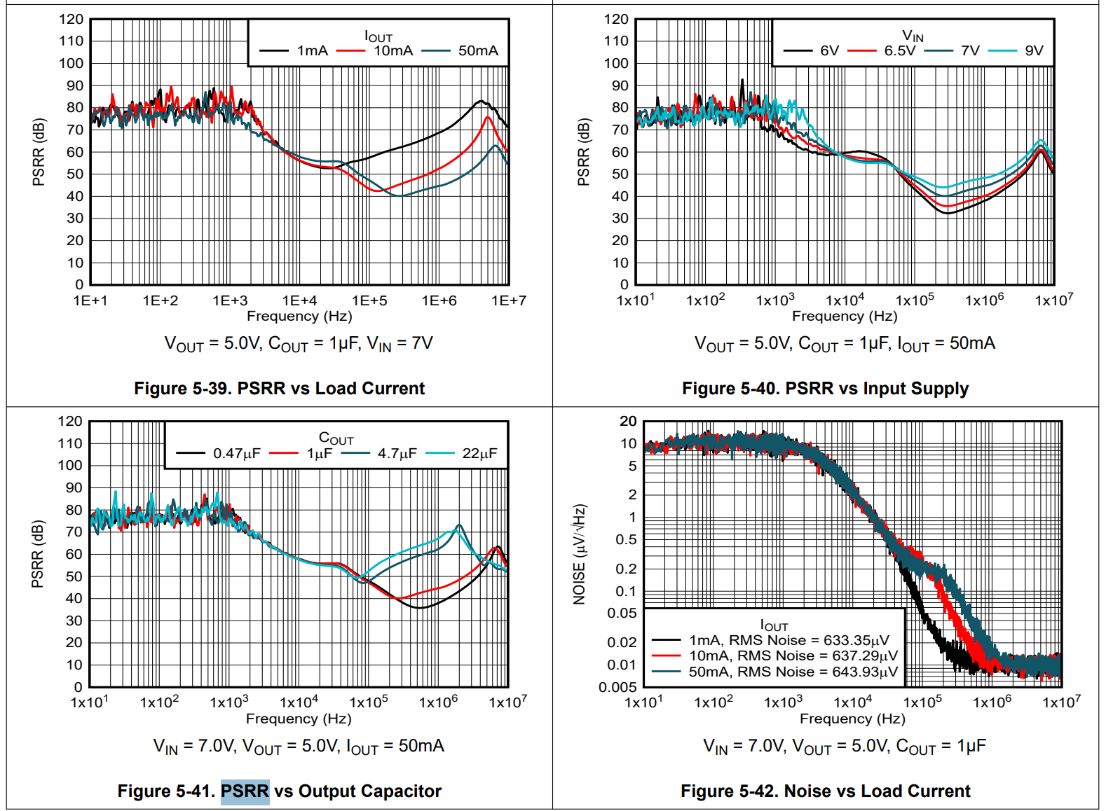
General law for LDO

Slide 22
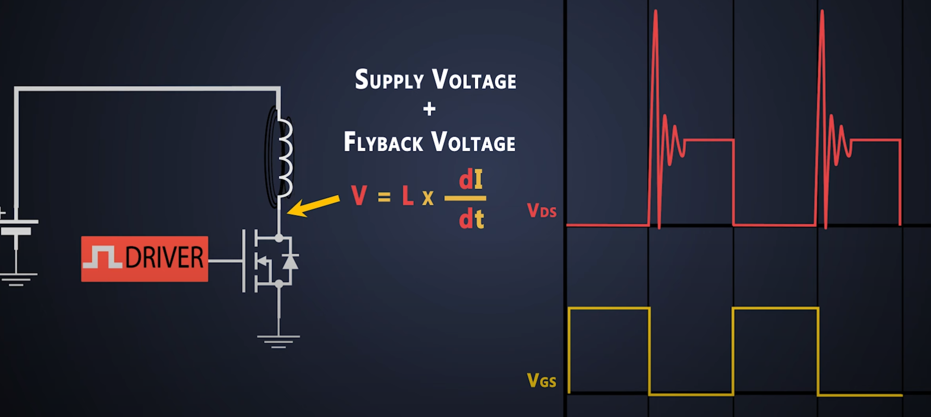
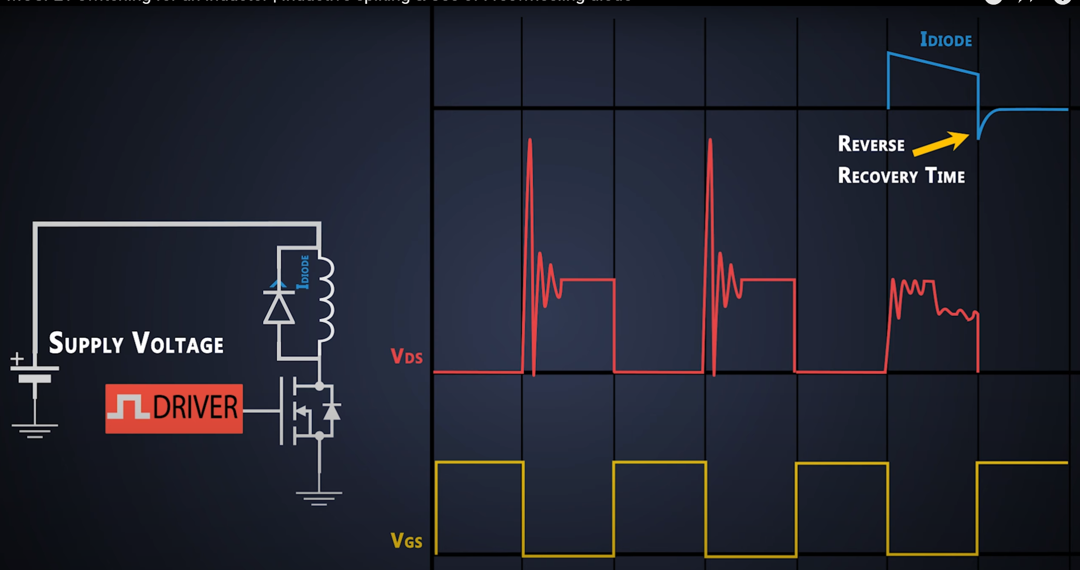
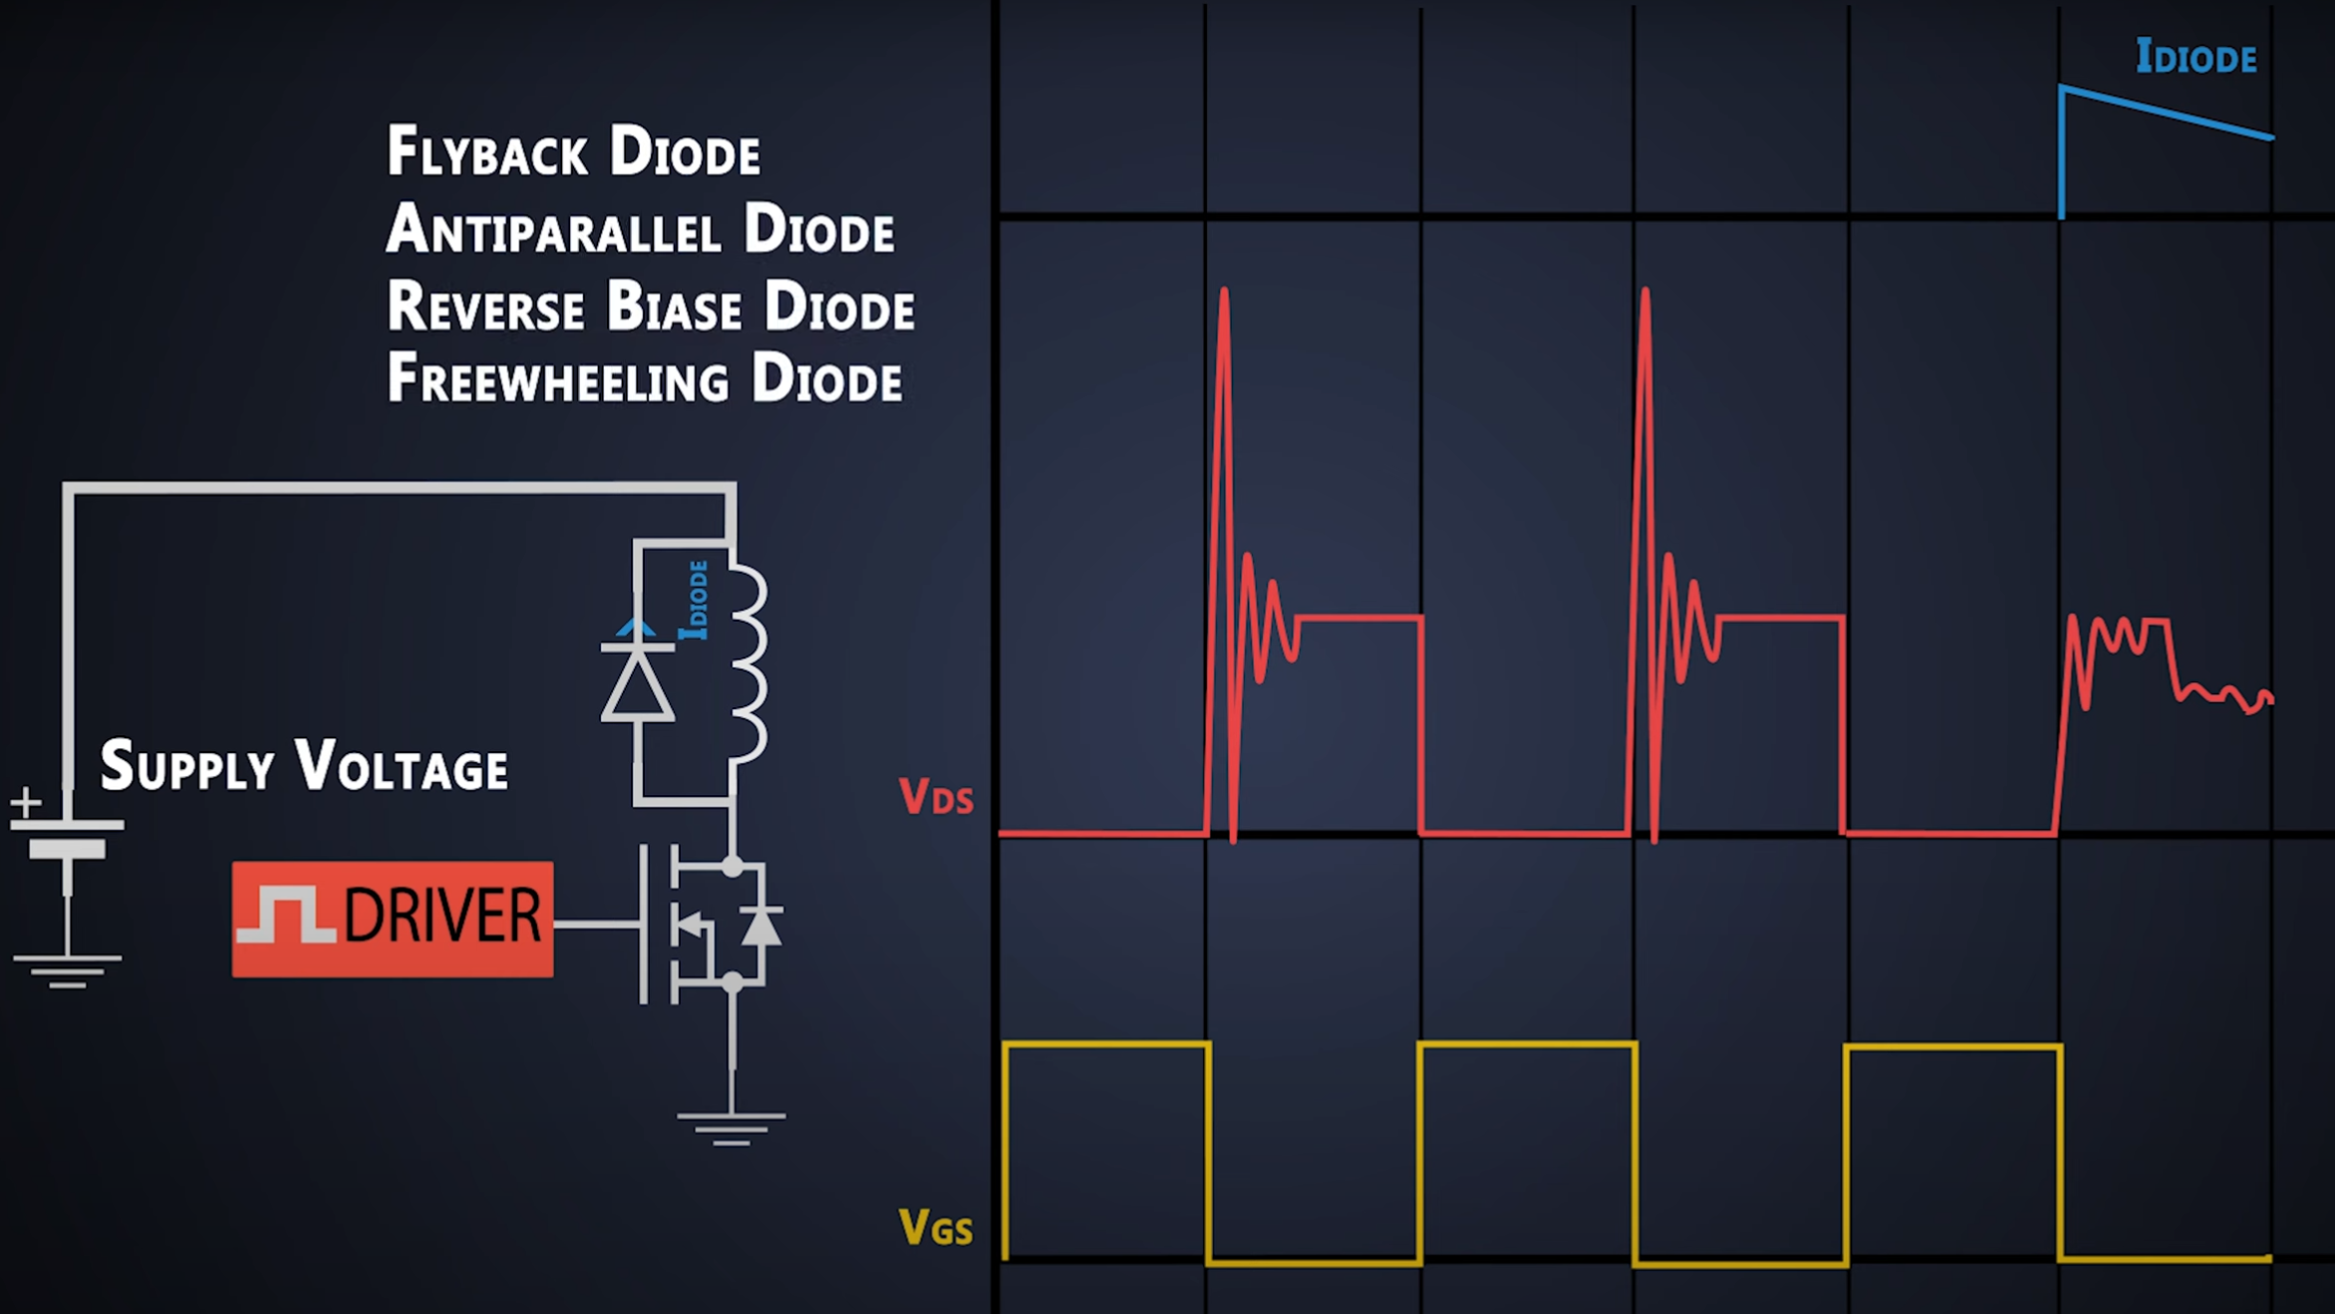

Mosfet behaviour due to inductance
Issue
Protection

Slide 23
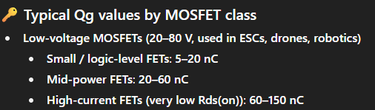
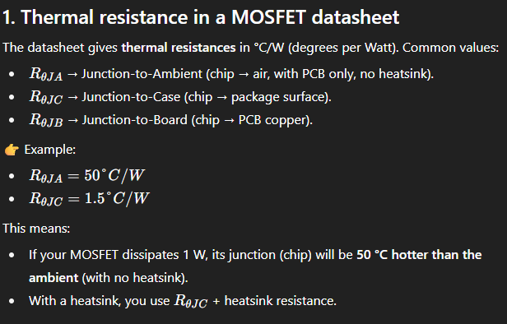
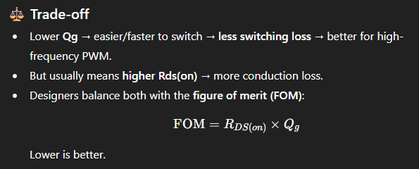
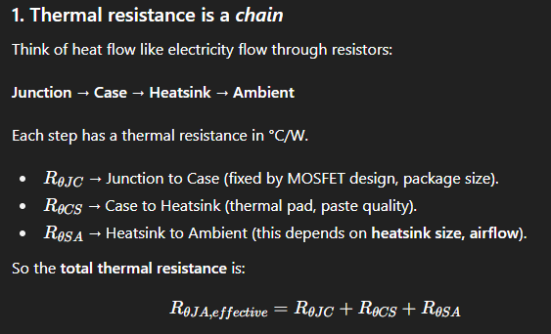
t_r = rise time => for the 2: <50ns if Rds<80V
t_f = fall time

Slide 24
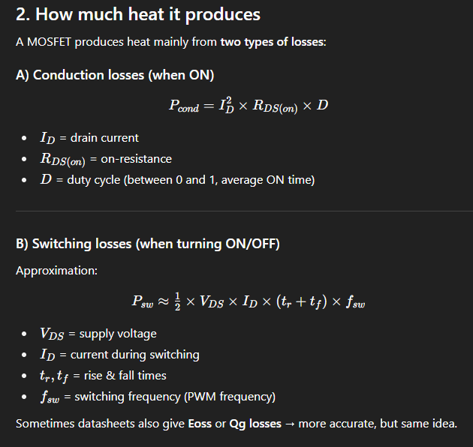
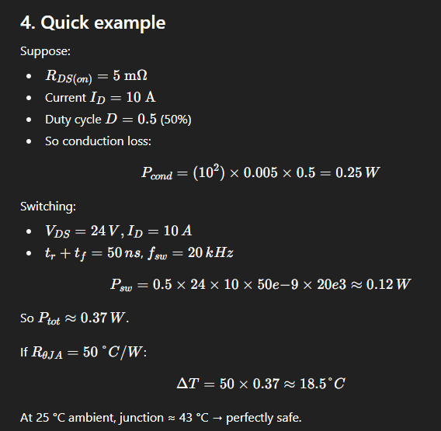
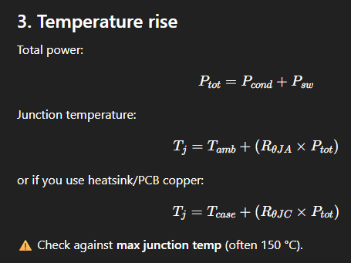


Slide 25
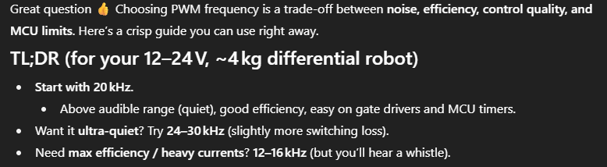
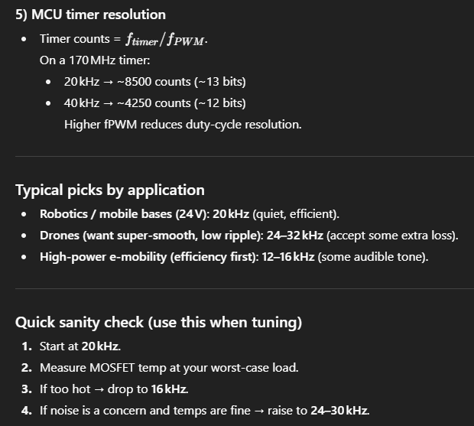
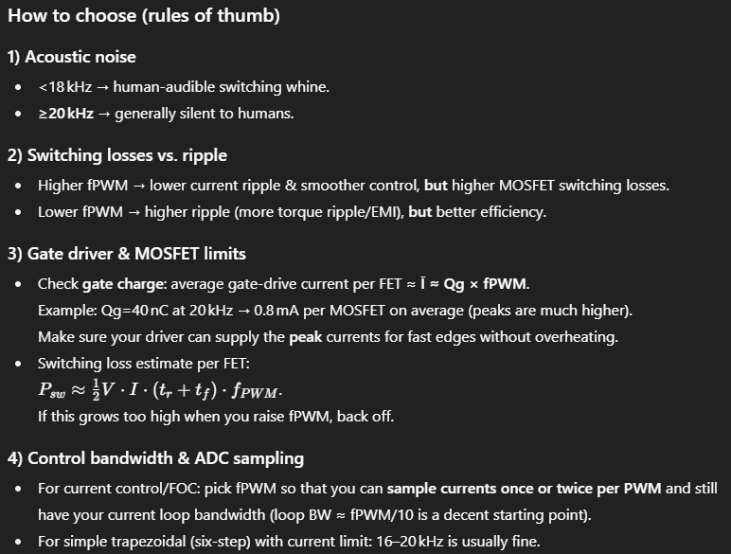
How to choose the PWM frequency ?
It can be set afterward

Slide 26
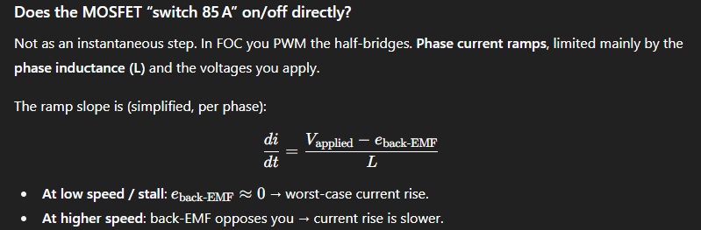
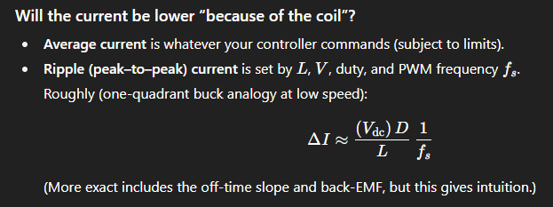
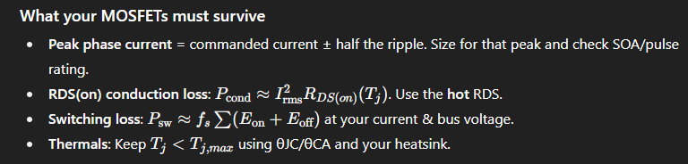
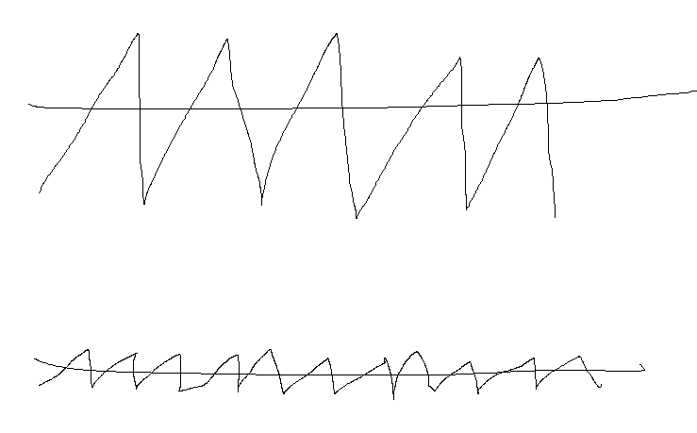

How does current rise inside the MOSFET+Motor loop ? Must I be warry of 85A for 3s ???
What does it mean ? => PWM impact on current ripple

Slide 27
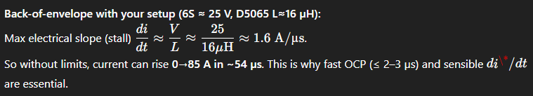




How to not burn anything ???
-> Current must be checked at any time and limited

Slide 28











MOSFET SELECTED: NVMFS5C604NLAFT1G
To take with water flanks
We will need little cooling

Slide 29







Using 10V fpor the gate results in a faster switching but a higher R_ds
On va prendre 10V

Slide 30


Slide 31

Gate driver

Slide 32


Gate driver: MP1922GV-Z
Idea behind the gate driver to send more that
Sizing: https://community.infineon.com/t5/Knowledge-Base-Articles/Estimating-the-important-parameters-of-a-gate-Gate-driver/ta-p/816852?nobounce
Note, driver do not exactly do this better (no losses, independent)

Slide 33





Slide 34













Chosen
To STM32
Thus, R_ds is 0.97 (typ) and 1.2 (max). Lets take 1.085 ohm.
Drain
Gate
Source
Power
STM32
MOSFETs control
Sensors and reference

Slide 35









How to process a fault
Can be linked for auto restart
We need a strat taking into account the 3 GD
Deactivate CS
Deactivate CS
For 10V => Qg=110nC
Cboot = 880nF
Cboot = 1000nF = 1*µF
SR to define, 10komh should be fine

Slide 36


FS = Full Scale
I_fs=100A and V_shunt=50mV => R_shunt=0.5mOhm
R9=R10=R11=1.5mOhm
CSR = GND
50mV*x=3.3
thus 3.3/50*1000=66 => R_csg = 30kOhm (G=52.5)

Slide 37

4mm bullet connector

Slide 38

Resistors

Slide 39


Slide 40










https://www.youtube.com/watch?v=7gz98K_hCEM

Slide 41





Slide 42



Slide 43
TAGS to use
To remove duplicated code at linking time
-ffunction-sections
-fdata-sections
-Wl,--gc-sections,--icf=all

Slide 44
CNN pas trop dur -> En une heure
Data synthetique
Bien rechercher pour les datasets
Analyse de l’homogenité du dataset (biais du au nombre de chaque erreur)
DATABASE
Pas de continual learning mais automatization de la detection de vrai classes de défaut (attention au taux d’erreur)
Note = note*defaut classe differentes Yolo en premiere etape ULTRALITICS, detect super rapidement
Supprimer des couches lors de l’entrainenment pour la robustesse (dropout)

Slide 45
VOCAB ANGLAIS
Hard sledding: dur/parcours du combattant. Sledding -> luge: parcours glissant
Design an algorithm absorbedly: desginer un algorithm de maniere approfondie

Slide 46
Ressources
Understand kV: Understanding KV Rating in Brushless Motors – HobbyGradeRC.com
Motor List and info: ODrive motor guide - Google Sheets
Encoders List and info: ODrive encoder guide - Google Sheets
Video on basics of FOC: (33) What is FOC? (Field Oriented Control) And why you should use it! || BLDC Motor – YouTube
Matlab FOC control: Field-Oriented Control (FOC) - MATLAB &amp; Simulink
Designing the MBLDC, a Custom ESC and BLDC Driver: Designing the MBLDC, a custom ESC and BLDC driver – Maakbaas
Thermal vias: How Thermal Vias Dissipate Heat in PCBs | Sierra Circuits
Cool analogy for capacitor: https://www.youtube.com/watch?v=KSylo01n5FY
Design of a 5V regulator, simple video: https://www.youtube.com/watch?v=d-j0onzzuNQ
Good motor enclosure and tuto about FOC: https://www.youtube.com/watch?v=AmS22zwl2EA
Gate driver working principle: https://www.youtube.com/watch?v=YeUbmOKi0Q4 (total tutos: https://www.youtube.com/playlist?list=PLbGlpmZLQWJceSkQv96j-L4YyuxS-E0Wm)
Phil’s LAB: STM32 with Kicad (https://www.youtube.com/watch?v=nkHFoxe0mrU)
Back-EMF explanation: https://mechtex.com/blog/back-emf-in-bldc-motors-a-complete-guide
Detailed pdf on sensorless control using BackEMF: https://www.nxp.com/docs/en/application-note/AN1913.pdf
Completition with FOC of previous source: https://www.nxp.com.cn/docs/en/application-note/AN1930.pdf
STM32 tuto: https://www.youtube.com/watch?v=dnfuNT1dPiM
C code deployment MatLab : https://www.youtube.com/watch?v=LAcnV_5GruY
FOC controller: https://www.youtube.com/watch?v=e0sQnVmE7DU
STM32 on 6 steps: https://wiki.st.com/stm32mcu/wiki/STM32MotorControl:6-step_Firmware_Algorithm
STM32 from bare metal, advanced principles: https://www.youtube.com/watch?v=7xnUsPo_fG8

Slide 47
Definitions and Acronyms List

Slide 48
Ressources FOC control
Pich detection using an egg: https://www.youtube.com/shorts/0jK4JGhhrNY
Control torque: https://www.youtube.com/shorts/SaAPLW2w2H0
Simple DIY BLDC: https://www.youtube.com/shorts/Ujhx4hHET3U

Slide 49



Annexes

